Slide 1

Health Systems Research –
Product, Process & Impact
Mike English & Team

Slide 2
What are we trying to achieve?
All parties | Direct outputs / answers
Most or some parties | Indirect outputs: Capacity building Policy influence Policy / practice change
Few parties | Dynamic engagement with co-evolution of research, policy, capacity and practice

Slide 3
Research Products
?
Question
Research
Answer
Change

Slide 4

Effects or Outcomes

Slide 5
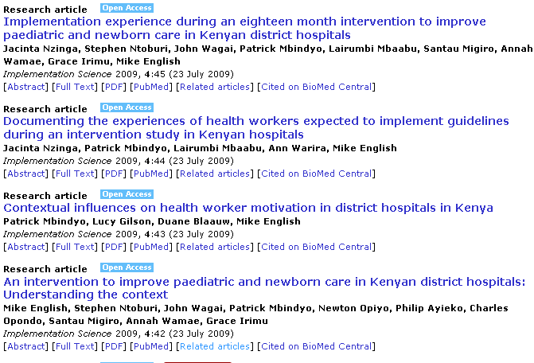
What might affect intervention effectiveness?
Adequacy
Acceptance
Context & Modifiers

Slide 6
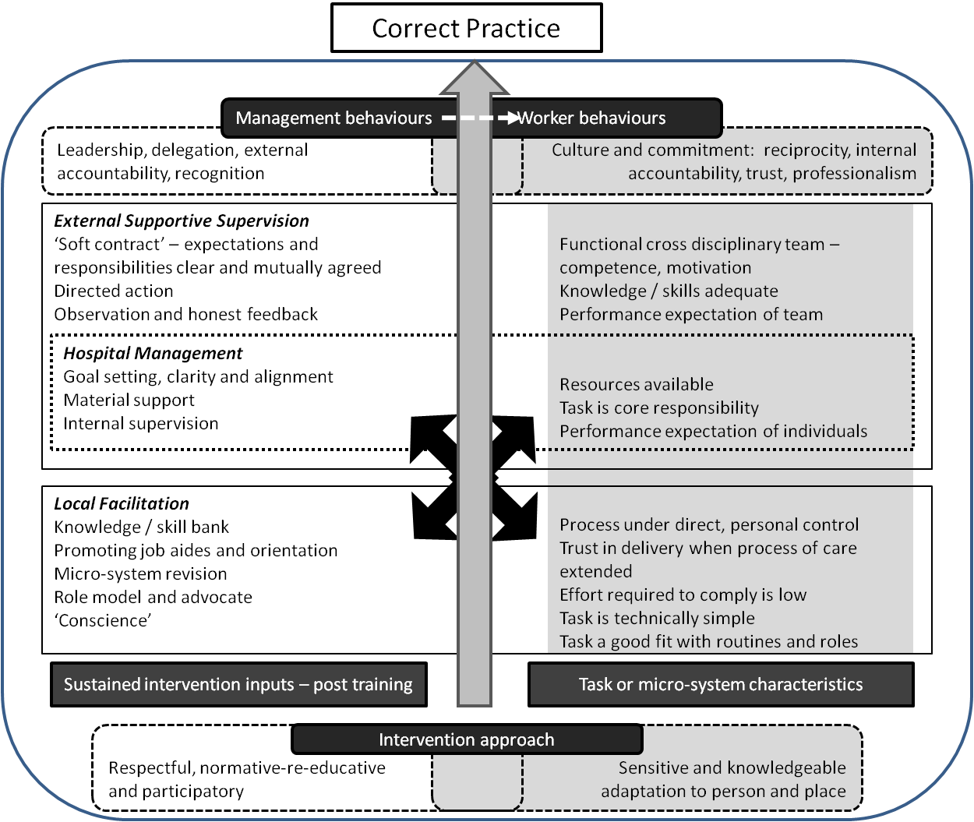
Mechanisms

Slide 7
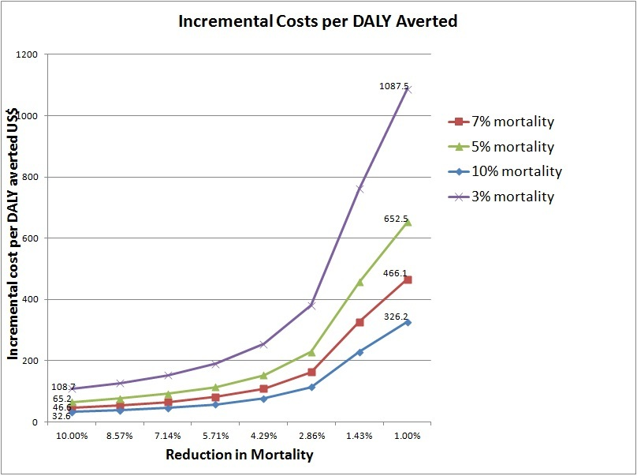
Cost effectiveness – cost per DALY averted

Slide 8
Process & Impact

Slide 9

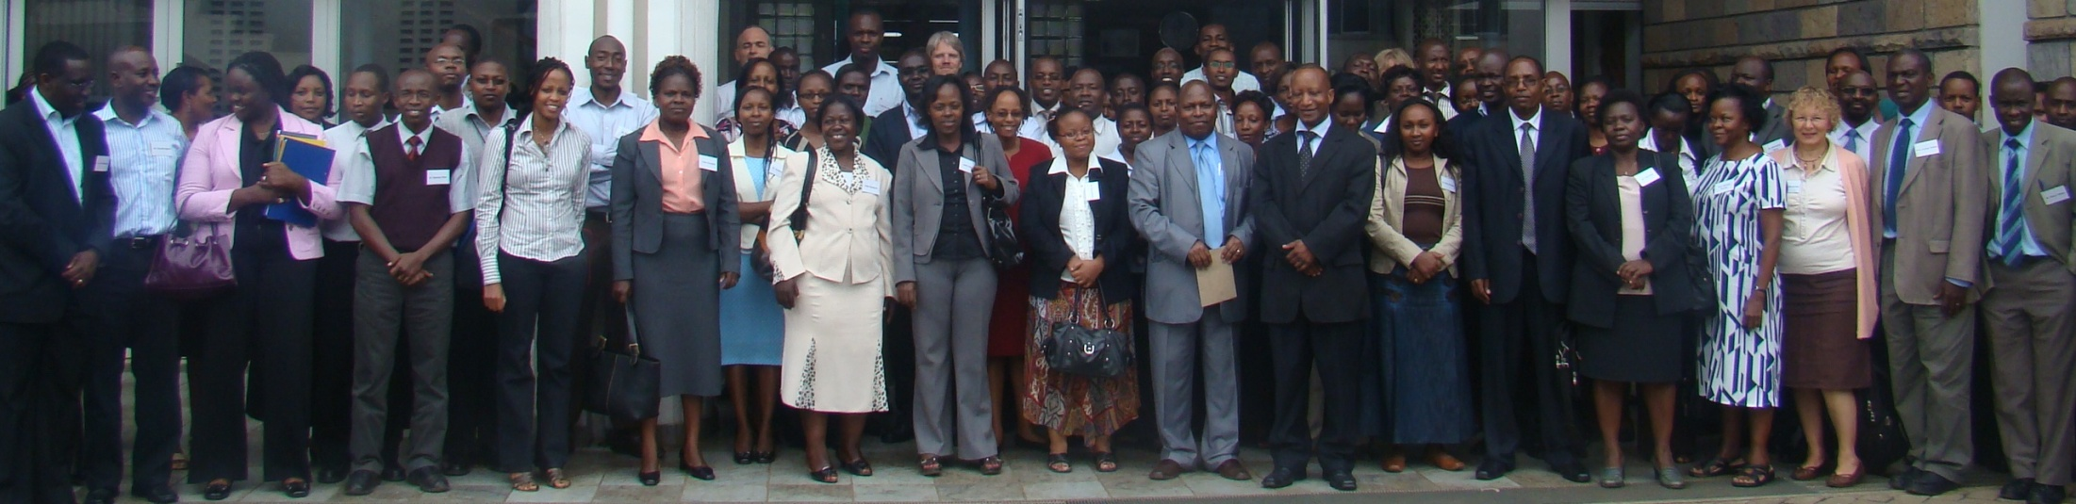
Policy Influence - Evidence based GoK guidelines
Key Clinical Questions
Child Health Evidence Week 2005
Child Health Evidence Week 2010
  Systematic Reviews and GRADE summaries
  Draft recommendations
  Consensus based decision making using GRADE Grid

Slide 10
Policy influence & practice change
22,000 copies of guidelines distributed in Kenya
Training included in government Annual Operating Plan & Global Fund application
Guidelines now printed in Rwanda and in development for Uganda

Slide 11
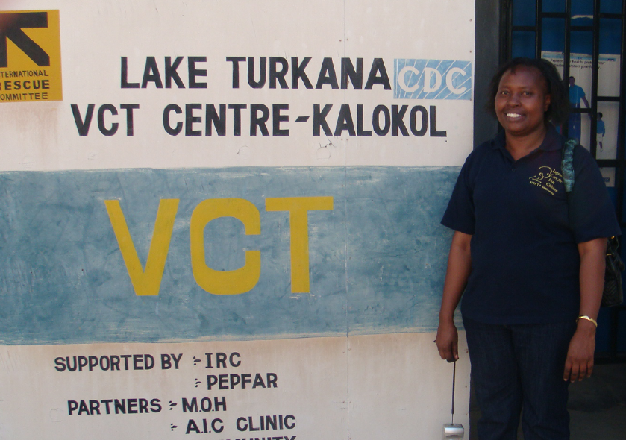
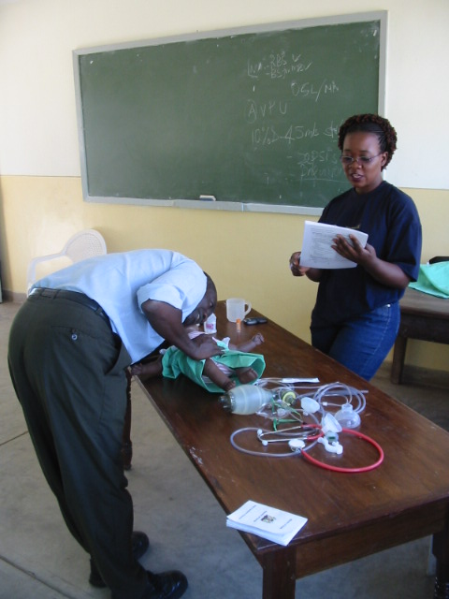
Practice change:
Kenya Training:
  1800+ Health Care Workers
  88 lecturers at nursing and clinical officer training schools
Courses for Dadaab and Kakuma Refugee Camps for International Rescue Committee
Training introduced into Rwanda and Uganda and part of LSHTM’s 1st East African DTMH in 2011

Slide 12
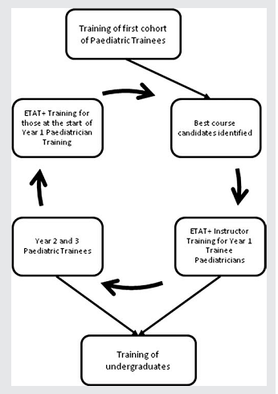
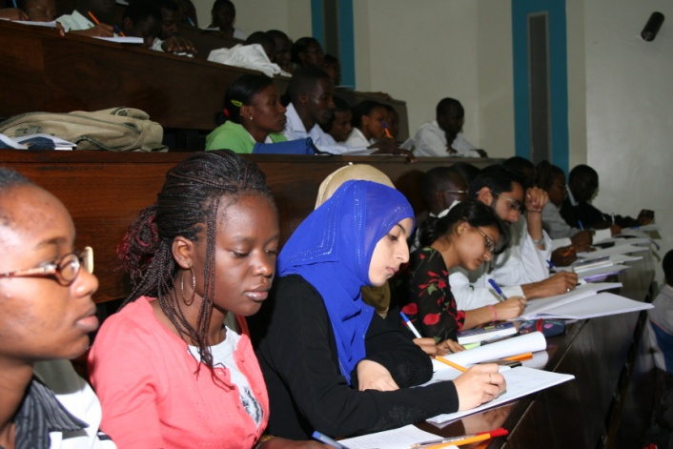
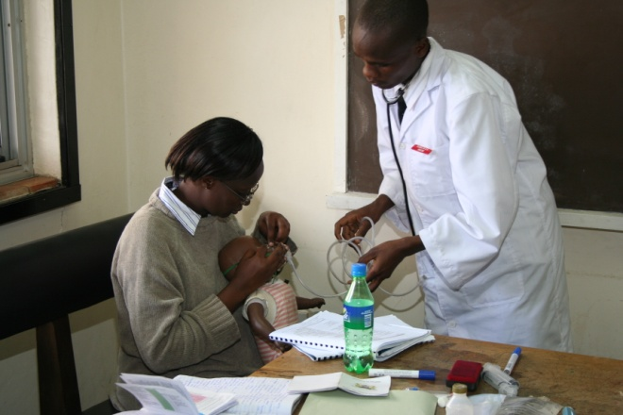
Practice change - Training Medical Students
Trainee paediatricians become ETAT+ instructors and train 300 students per year

Slide 13
Capacity building
Kenyan researchers:
  PhD 4
  MSc 5
  Multiple Kenyan 1st author publications
Capacity building
Project
Time

Slide 14
Policy influence & practice change
Effort & resources
Policy Influence & Practice Change
Impact
Capacity building
Project
Direct outputs
Time

Slide 15
Bigger vision – Grand challenge
Project(s)
Project(s)
Project(s)
System
Policy
Practice
Research
Impact and System Change
Research Capacity
Technical Capacity

Slide 16
Summary
All parties | Direct outputs / answers
Most or some parties | Indirect outputs: Capacity building Policy influence Policy / practice change
Few parties | Dynamic engagement with co-evolution of research, policy, capacity and practice

