Slide 1
Influencing policy-making Results of a multi-country study
(London, 13 December, 2011)
Dr Abdul Ghaffar
Executive Director

Slide 2
Project Description
Alliance issued a call for proposal in 2008 to strengthen evidence to policy links in LMICs, with the following objectives:
(a) To build capacity of researchers to synthesize evidence and package it in policy friendly manner;
(b) To establish/strengthen structures and mechanisms to link researchers & policy makers to promote uptake of evidence; and
(c) To use this experience to add to knowledge base about which strategies worked.
Six country teams supported for 2 years

Slide 3
Approach
Building capacities of researchers & research users in acquiring, assessing and packaging information
Producing policy briefs on priority topics
Disseminating evidence to policy makers and stakeholders through policy dialogues
Creating/strengthening Knowledge translation platforms linking evidence to policy
Evaluating the project using questionnaires and key informant interviews

Slide 4
Key achievements
Generation/dissemination of evidence
27 Policy briefs prepared and circulated among policy makers & stakeholders
Websites created providing access to evidence
Operational manual prepared for strengthening institutional capacity to employ evidence
Policy-research links created
Increased engagement of policy makers and researchers through policy dialogues
Increase in demand for evidence from policy makers
Committee within MoH created in Ebonyi, Nigeria linking 7 Directors of health with researchers
Capacity building
About 250 decision-makers are trained in using evidence for policy making

Slide 5
Impact on policy making
In Nigeria, evidence in policy briefs contributed to
State Strategic Health Plan 2010-2015
Launching State Helminthic Control programme for school children
In Cameroon, policy briefs on malaria and insurance influenced national policy making
In Zambia, based on policy briefs the government is preparing implementation plan on retention of human resource and on preventing post-partum haemorrhage
Increased demand of evidence from MoH on its priority programmes

Slide 6
Key lessons learnt
Factors to consider
Institutional factors
Teams with strong institutional base performed better
Links between academic and policy institutions had a positive influence
Factors influencing uptake
Acceptability of the institution within power circles
Prior experience of engagement with policy makers
Having a potential role in policy making
Focusing on priorities of the policy makers
Policy environment
Willingness of the MoH to participate
Strong political support

Slide 7
Key lessons learnt
Challenges
Frequent staff turn-over
Weak organizational capacities for evidence informed policy making
Lack of organizational culture to use evidence
Sustainable structures and mechanising

Slide 8
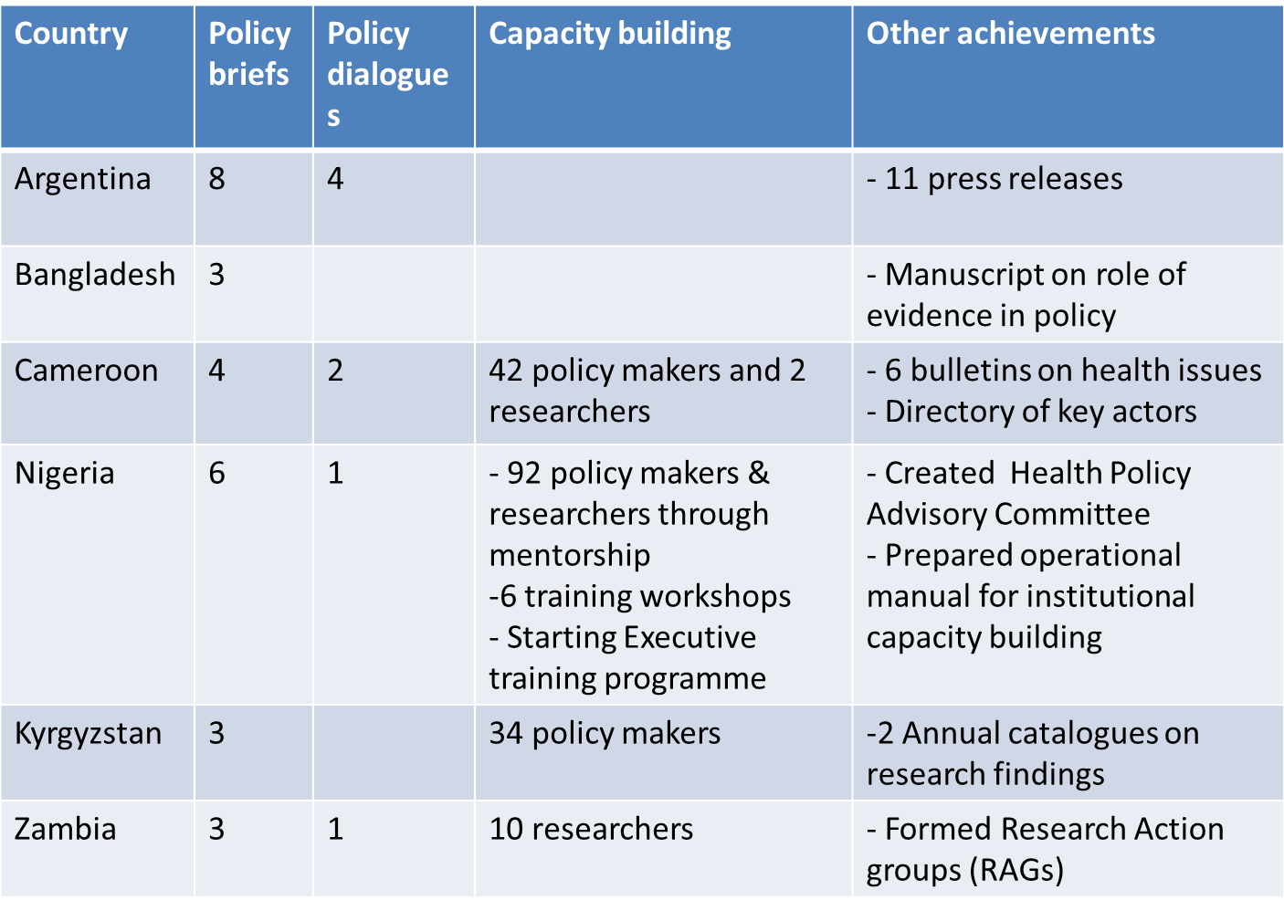
Outputs

Slide 9
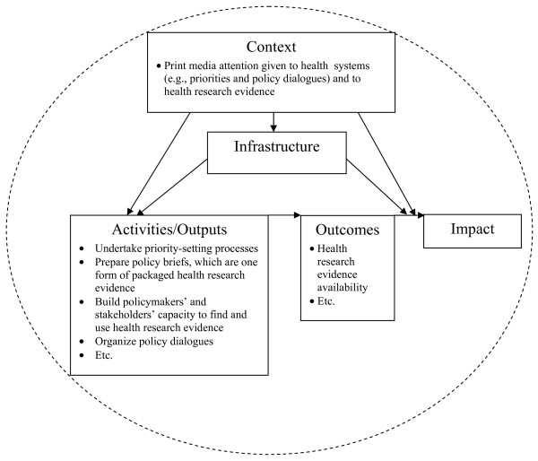
The M&E framework
Source: Cheung A, Lavis JN et al. Climate for evidence-informed health systems: A print media analysis in 44 low- and middle-income countries that host knowledge translation platforms. Health Res Pol Syst 2011;9:7.

Slide 10
Thank You !
ghaffara@who.int

