Slide 1
What factors enable relevant research evidence to influence policy and practice?
Dr. Sally Theobald 14/12/12

Slide 2
Overview
Health systems: Multiple players, multiple perspectives
Introduction to our research uptake research - SRH
Adapting the RAPID ODI framework to frame qualitative research findings
Classifying the strategies researchers and advocates have used in ‘research engagement’
Examples of research engagement in the current round of RPCs

Slide 3
Multiple players and diverse strands
Health systems are diverse and complex and contain more actors than policy makers and practitioners – including private companies, different types of social entrepreneurs, civil society organisations, faith based organisations.
Multiple disciplines and methods
Review Sexual and Reproductive Health - politicized, sensitive and often contested arenas of sexual and reproductive health.
Multiple disciplines and methods

Slide 4
Sexual Health HIV Evidence into Practice (SHHEP)
Use of DFID RPC
funding - explore engagement
Sexual Health HIV Evidence into practice
Increasing interest
in impact
of research
Notes:
Increasing interest in impact of research amongst researchers, advocates and donors
Use of DFID RPC funding as a framework to explore research engagement in SRH & HIV
Sexual Health HIV Evidence into Practice (SHHEP network)

Slide 5






Special supplement of HARPS
ABBA RPC

Slide 6

Impact and engagement
“Research that doesn’t just gather dust on library shelves...”

Slide 7
Supplement foreword
The work reported in this supplement provides examples of approaches that have been tried and from which
other researchers can learn. They demonstrate that getting research into policy and practice is complex, dynamic
and multi-faceted; and a wide range of context and issue specific conceptual and practical approaches have to be
used. I hope that the innovative approaches and promising ways forward, presented in these papers, will inspire
and motivate others.
Professor Christopher Whitty & Dr Sue Kinn

Slide 8
Questions for the special issue
How do SRH and HIV/AIDS research organisations describe their policy influencing aims, and who are the policy makers they seek to influence?
What influencing strategies and approaches are used by SRH, HIV and AIDS research organisations and how are these shaped by methodology, context and subject area?
What are the different ways in which research evidence is strategically framed in order to maximise impact?
What strategies do research organisations use to track the impact of their work?
From the perspective of research organisations, what models and conceptual frameworks are helpful?

Slide 9
Organised into five themes
Theme
one
Theme
two
Theme
three
Theme
four
Theme
five
Theory
and
practice of research engagement
Applying policy analysis to explore role of research evidence
Strategies
and methodologies for
engagement
Advocacy and engagement to influence attitudes
Institutional approaches to intersectoral engagement for action and strengthening communications
Notes:
Theme 1: The theory and practice of research engagement
Theme 2: Applying policy analysis to explore the role of research evidence in SRH and HIV/AIDS policy
Theme 3: Strategies and methodologies for engagement
Theme 4: Advocacy and engagement to influence attitudes on controversial elements of sexual health
Theme 5: Institutional approaches to intersectoral engagement for action and strengthening research communications.

Slide 10
Literature on research to policy fast growing
ODI RAPID
IDRC
ESRC
WHO
HRSA
Less common is reflection from researchers or
research-funding organisations themselves about the
ideal roles of research organisations, about the compatibility between research and communications objectives, and about some of the tensions and challenges involved in policy influencing.
Notes:
Health Research Systems Analysis (HRSA) Initiative

Slide 11
Strategies and tensions in communicating
Research on sexual reproductive health, HIV and AIDS
Qualitative study focuses on the research communication and policy influencing objectives, strategies and experiences of four research consortia working on SRH, HIV and AIDS
22 in-depth interviews with researchers and communications specialists (research actors) from the four consortia and their partners, working in nine countries in sub-Saharan Africa and Asia.
2 interviewers
As research authors working in RPCs, we are also participant observers in the institutions and processes that we are studying and undertook a reflexive approach to interviewing and analysis (England 1994).

Slide 12
Findings in a nutshell
We identified a trend towards increasingly intensive and varied communication approaches
Effective influencing strategies
    Embedding in context
    Making strategic alliances and coalitions
    Strategic framing
Tensions
    Identify and avoid unnecessary communication or unintended impacts
    Challenges in assessing and attributing impact
    Adequate resources and skills for communications work.

Slide 13
Influencing strategies
Reframing contested issues
Extending or shifting mainstream issues
Highlighting neglected issues
Creating public discussions of congested and neglected issues
Notes:
Creating public discussions: BRAC has worked to change attitudes of key government and media stakeholders towards sexuality in Bangladesh. This included holding a public meeting on sexuality, careful and active recruitment of participants, and capitalising on credibility held by academic institutions in Bangladesh to ally with
queer groups. (See: Rashid et al., this issue)
Reframing contested issues: APHRC’s presentation of the results of their Protecting the Next Generation project at two international conferences, the first in Tanzania in 2007 and the second in Nigeria in 2008. The first time the information about the early age at which young people are starting to have sex and the
need to provide them with SRH information and services was met with concern and anger by audiences, and the second time they presented the same messages in a more sensitive way (e.g. emphasising the importance of parents in young peoples’ lives and the dilemmas parents face) but with the same policy conclusions, the audience had a much more favourable reaction.
Highlighting neglected issues: Bringing work on congenital syphilis higher up the policy agenda in Ghana through collaboration with the Ghanaian MoH. Generating buy-in for research findings at the national level through working with WHO on STI treatment and management guidelines (LSHTM and SRH and HIV partners).
Extending or shifting mainstream issues: Strategic use of high profile conferences on relevant subjects. For example Evidence For Action (UK) held a satellite meeting at the XVII Mexico AIDS conference to share experience of using and generating evidence to improve HIV treatment and care systems in resource-poor settings. A communications officer from IDS (UK) sent out a blog from this meeting highlighting links between unfolding HIV debates and research from the Realising Rights consortium.

Slide 14
Adapting the RAPID conceptual framework , (Crewe and Young 2002; Court and Young 2003)
To include an explicit focus on research actors’ positionality in policy processes
This approach can help researchers and communications specialists to reflect on their unique combination of attributions and skills, make explicit their influencing goals, and to use this reflection in their influencing strategy.

Slide 15
External context
Political context
Research actor’s characteristics and
actions
Links
Evidence
Notes:
Note: this is Figure 1. The research-policy interface

Slide 16
Position and skills of research actors
Diversity in characteristics, actions and organisational approach
“You know many good researchers don’t make good advocates. Quite a different skill and I think that's very rarely recognised. A good academic is trained to […] state the […] cautions, the doubts, whereas those are fatal qualities for an advocate who has to simplify, dramatise, exaggerate.”
(Researcher, LSHTM, UK)
‘‘I’m pushy and I think of everything as an opportunity and I don’t shut doors and I keep resisting […] I am always looking for ways [for there to be] something more than just research in a book. Because […] I work a lot with poverty and urban poverty and especially […] in urban slums, I think [in terms] of the rights perspective or the structural inequalities for poor people.”
(Researcher, BRAC University, Bangladesh)

Slide 17
Investing in research uptake
“The role of our research communications officers has
changed the way that we as researchers [...] relate to
influencing work and policy work. They are experts at that
and without their help I think we would still be producing
little interesting consultancy reports or publishing
articles, but now its much more diverse, strategic and
proactive.”
(Researcher, IDS, UK)
Communications
RU staff
Communities
of practice

Slide 18
Context and strategic opportunism
Attitudes to sex and sexual rights
“Being a doctor I know what HIV is but in terms of the nuances and the politics and the understanding what to say, when and all that, I have been on a learning curve myself […] it’s been a little more challenging than the regular areas that I have been involved in […] In the African environment, issues about sex and sexuality are not discussed in the open […] and there is the need for us to get those issues addressed appropriately.”
(Researcher, Health Research Unit, Ghana Health Service)
Key theme
Notes:
A repeated theme from interviews with researchers working on SRH and HIV/AIDS was how attitudes to sex and sexual rights have an important influence on the uptake of policy in their field. Compared to many other research areas, cultural and social factors are strongly influential in political processes in this area.

Slide 19
Networking and coalitions
Complex approaches
Different institutions, different approaches
Embedded, connected, forging relationships
Paradigm shift away from dissemination to ongoing partnerships
Simultaneously
“If you do [research] in partnership with government they easily accept the findings and take it up. […] if they were our partners from the very beginning of that project then they would easily believe its credible.”
(Communications Officer, APHRC, Kenya)

Slide 20
Evidence, messages and rallying ideas
Methods – trends and receptivity
Legitimacy and the who of presenting
“At the national level I would always take a step back, I think it is the prerogative and actually the duty of the national researchers to be the people at the forefront, they are the credible people, they are the ones to their national government.”
(Researcher, UK).

Slide 21
Categorising research impact
Young and Mendizabal model
Discursive changes
Content changes
Procedural changes
Behavioural changes
Change discourse
Change
laws / policies
Change how health related governments ministries or agencies analyse their data on service delivery
Raised awareness, attitudinal, building national capacity for research
Notes:
Discursive changes – change discourse – Opening new public spaces/discourses on representations of sexuality in Bangladesh (Rashid et al [11])
Challenging key academic or policy discourses, for example on health economics and on Children and HIV, and gender and masculinities (Crichton and Theobald [3])
Content changes – change laws / policies - Change in law to exempt survivors of gender-based violence from paying medical costs (Tulloch et al [9])
Research to analyse the process of uptake of Cotrimoxazole preventive therapy in Zambia, Uganda and Malawi and draw out lessons on policy change (Hutchinson et al [5])
Procedural – change how health related gov ministries or agencies analyse their data on service delivery - Gender disaggregated data and equity analysis of ART data now part of MoH processes (REACH Trust, Malawi) (Crichton and Theobald [3])
Behavioural – Raise awareness of and access to research and capacity to understand it - Media engagement and media capacity building:
Raising awareness about health and rights through an entertaining and engaging drama – Makutano Junction (Oronje et al [6])
Support attitudinal change - The Pleasure Project’s global mapping of pleasure used research to promote sexy safe sex (Knerr & Philpott [12])
Building national capacity to carry out research and identify the policy implications - Research was undertaken on OVC within the Ministry of Health and links developed with other government departments (Gyapong et al [13])

Slide 22
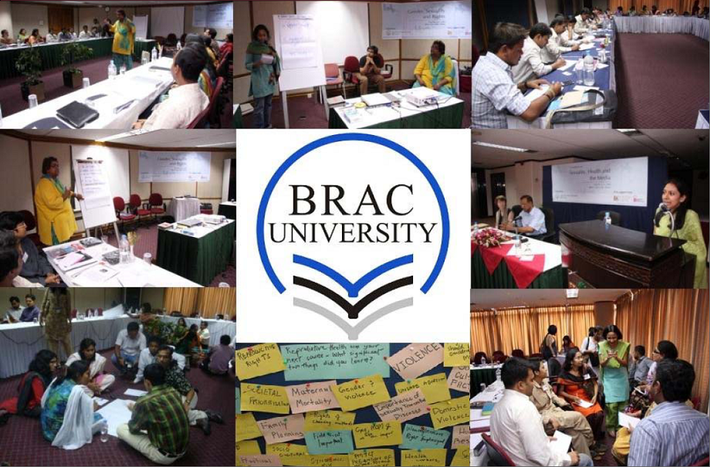
Change discourse

Slide 23

Change guidelines/develop new guidelines

Slide 24

Raise awareness of research and support attitudinal change
Extracts from information resources to raise awareness about rape, reduce stigma and inform Makutano Junction viewers about post-rape care services.

Slide 25
Learning from the SHHEP process
Investing in communications and research uptake matters...
Undertaking reflective assessments of the policy relevance of research evidence, its scope and limitations within a particular context and the ethical implications of communicating the research
Carrying out strategic scoping of opportunities and levers for influence through analysis of the policy context, actors and processes, including the political or cultural acceptability of research approaches and findings within context
Assessing the nature of the research evidence and consulting with other key actors on how best to frame it in ways that increase local decision makers’ receptivity.
Keeping communications strategies flexible, innovative, jargon free and relevant to research institutions’ objectives to keep them effective.
Being aware of the broad range of research impacts.
Notes:
Tie to health systems research

Slide 26



Looking forward the next generation of RPCs
Notes:
And ESRC DFID approach

Slide 27
Strategic approach to research uptake
Institutional level
“We appeared in Parliament to provide expert evidence about the proposed bill for maternal health and improving health systems in Uganda[...]research-policy engagements have taken off.
It’s a combination of strategic intent, institutional research credibility, individuals with the skills to work at the boundary of research, policy, supportive resources and more.”
(Freddie Ssengooba, MUSPH)
Dedicated staff; Research uptake success
Strategic intent, funding
Commitment, skills
Individual level

Slide 28
Conclusions
Transparency
Accountability
Researchers, communications and advocacy practitioners to work together
Identify objectives and most appropriate approaches for particular research projects
Sufficient resources required and continual capacity building

Slide 29
Questions?

